Slide 1
Natural Frequency of a
Cantilever Beam with an
End Mass

Slide 2
Objective
To compare
the natural frequencies
of a cantilever beam
with an end mass obtained from experiment and by theory.

Slide 3
Equipment Needed
FFT Analyzer
Beam with End mass
C clamp
Impact Hammer
Accelerometer
External power
ICP Battery Power Unit
Bees Wax
Masking Tape

Slide 4
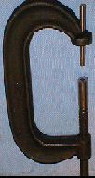
Equipment & Accessories
1. Equipment used for the experiment
Monitor
External Power
HAMMER
CPU
C Clamp
LOAD CELL
IN 1 & IN 2
ANALYZER CARD
Table
OUT 1 & OUT 2
ICPBattery2
XDCR SCOPE
ICPBattery 1
XDCR SCOPE
CABLES
Accelerometer
BEES WAX
MASKING TAPE

Slide 5
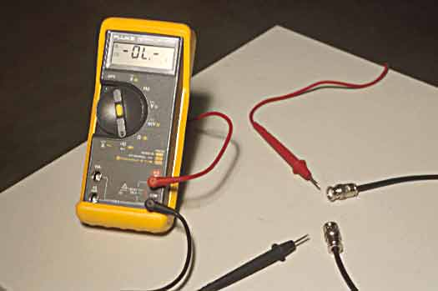
Using Multimeter
1. Check all the cables with a multimeter

Slide 6
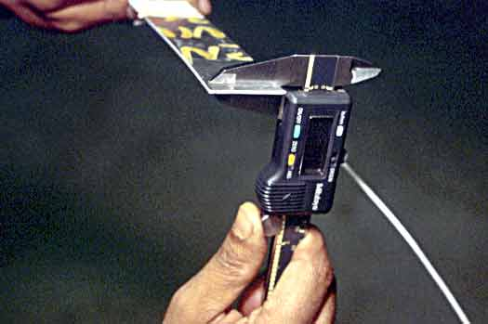
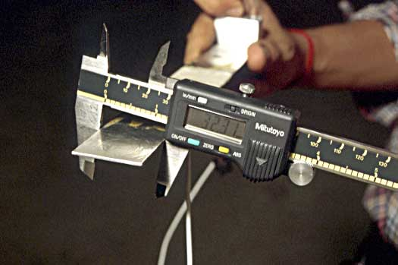
Beam Dimensions
Measure the width, length and thickness of the beam
Use the vernier calipers or the micrometer to measure the thickness
Turn off the battery of the Calipers

Slide 7
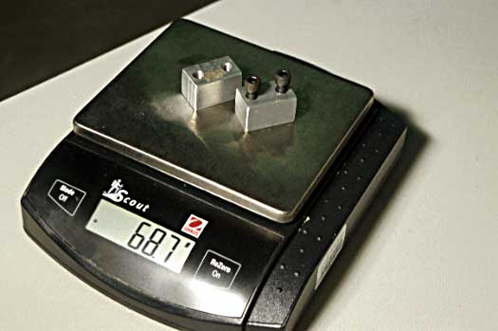
Mass Measurements
Weigh the mass on the weighing scale(Make necessary assumptions regarding the mass of the beam and justify them in your report)
Turn off the power after taking the measurement

Slide 8
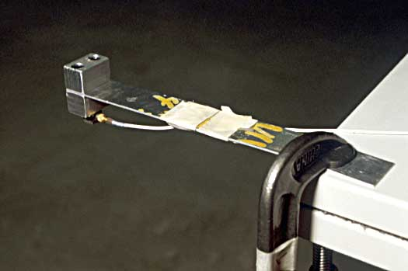
Setting up the Beam with End Mass
Check all the Cables with a multimeter
Measure the dimensions of the beam and note the mass
3. Mount the Cantilever bar with end mass to the bench with
the C clamp; mount it square to the table and keep in mind
the length considerations

Slide 9
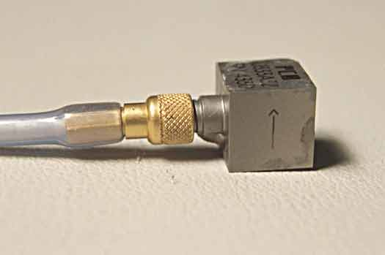
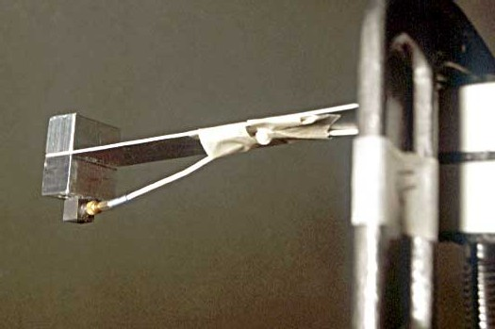
Mounting the Accelerometer
Use Bees Wax to attach the accelerometer to the mass
Mounting direction indicated on the accelerometer by arrow
Handle the Accelerometer with Care. It is Expensive
Use Masking Tape to secure it to the beam when cables are attached.
Note that the cable should not be taut after the set up

Slide 10
Connections
1. Secure the beam with end mass using C-Clamp
2.Mount the Accelerometer properly
3.Connect the end of accelerometer to XDCR terminal of the ICP Battery 2
4.Connect the end of Impact Hammer to XDCR terminal of another ICP Battery1
5.Connect the Scope end of ICP Battery 1 to IN 1 terminal of the Analyzer card
6.Connect the Scope end of ICP Battery 2 to IN 2 terminal of Analyzer card
7. Connect the ICP Batteries to power source and set gain to unity initially
Refer to Connections in Next slide

Slide 11
Connections
Make all the connections properly
Monitor
External Power
HAMMER
CPU
Masking Tape
LOAD CELL
ANALYZER CARD
IN 1
Ignore OUT1 & OUT2
Accelerometer
IN 2
ICPBattery 2
XDCR SCOPE
ICPBattery1
XDCR SCOPE

Slide 12
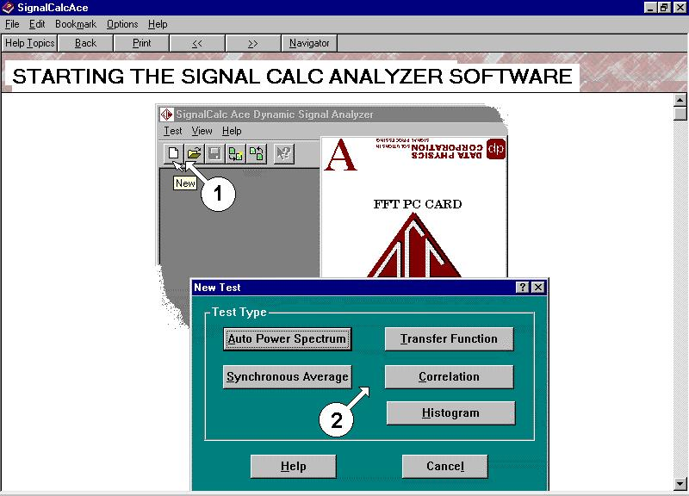

Analyzer Icon
Click on Transfer Function

Slide 13
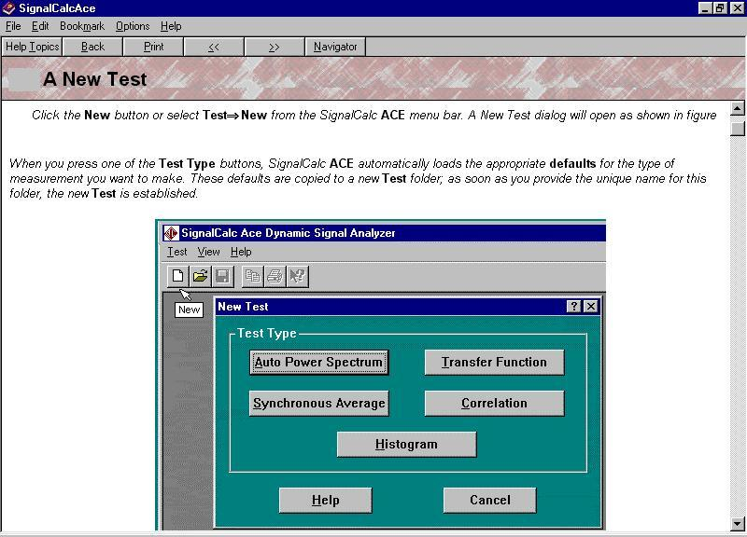

Slide 14
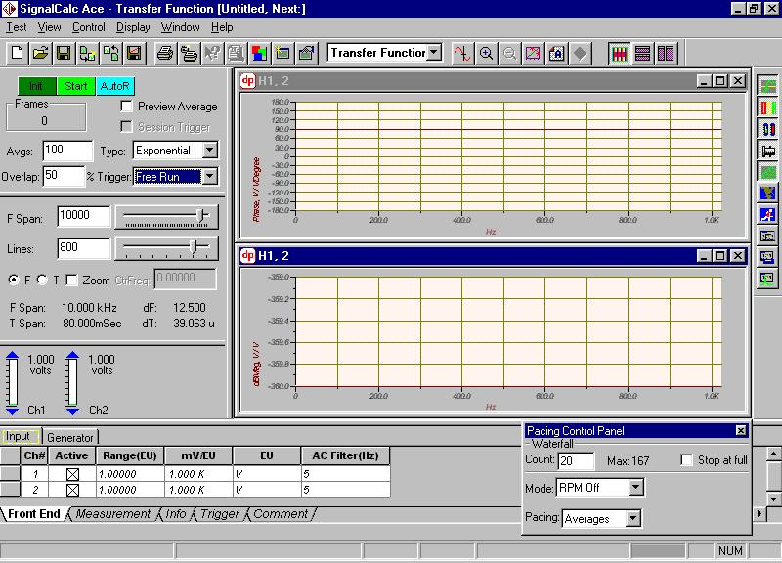
This will be the Opening screen
You may expect

Slide 15
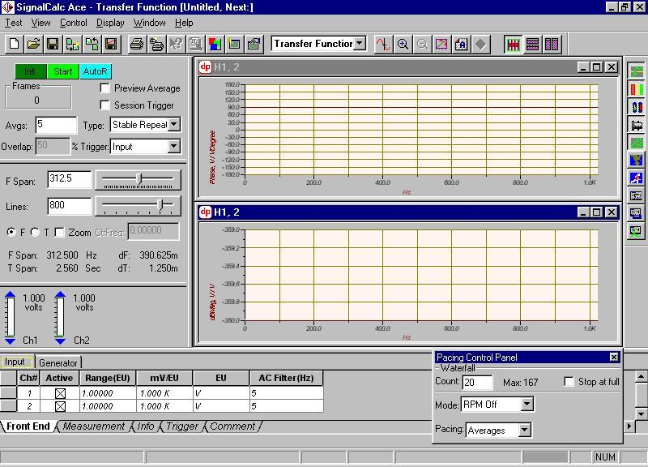
Menu Bar
Tool Bar with Short Cut Keys
Short Cut Keys

Slide 16
Sampling Parameters Settings
Measurement Parameters Settings
Channel Settings

Slide 17
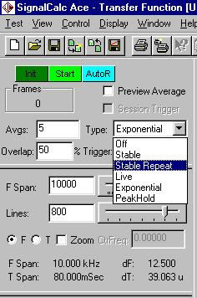
Measurement Parameters Settings
Frames indicate the number of averages collected,when test starts
Averages is the number of measurements desired to be taken,
in given case it is five(5)
Type indicates the weightage given to the averages collected. Refer Help contents for detailed explanation
Set Type to Stable or Stable repeat for the given experiment

Slide 18
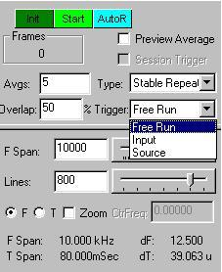
Setting Averages, Type & Trigger
Trigger Settings
Trigger indicates the source which initiates collection of data
Free Run option when selected causes the system to start data collection without waiting for any trigger
Source indicates triggering from a given data source
The Input option needs to be selected for the given test as the Impact Hammer acts as the Force Input

Slide 19
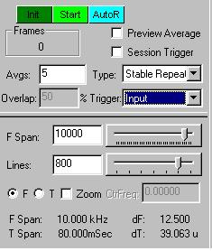
Sampling Parameters Settings
FSpan indicates the frequency span or frequency range of interest of experiment
Default value is 10000Hz
FSpan Value to be set after calculating value from theory
Lines indicate the resolution desired
Higher resolution implies more data, large file size and longer time. Hence a compromise needs to be made.
Actual Settings Next Slide

Slide 20
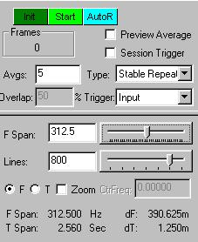
Sampling Parameters
In the given case, the frequency span has been set to a value of 312.5 Hz
The resolution may be set to 800
Note that you can change the values by dragging the slider or by manual entry
Ensure to press the Return key in case of Manual Entry
The Overlap field may be ignored currently

Slide 21
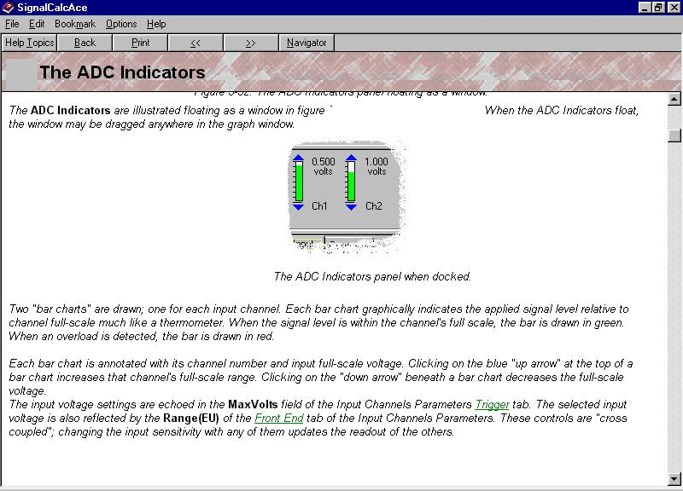
The signal level should be as close as possible to the full scale
without overloading the channel

Slide 22
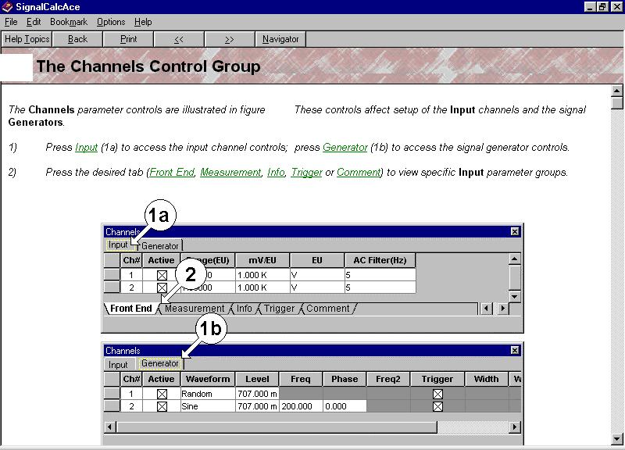

Slide 23
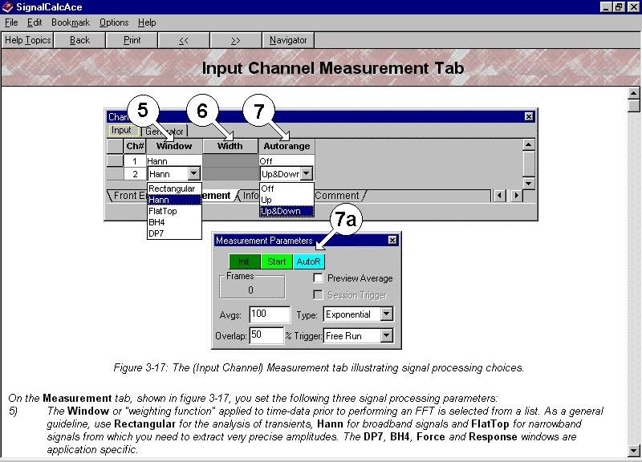

Slide 24
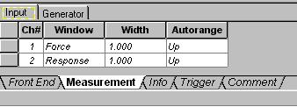
Input Channel Settings
Several Windows are available for measurement of various signals such as Hanning, Rectangle,Flat Top etc.
Refer Help contents for more details
Set Ch#1 window to Force as Hammer is connected to Channel 1
Set Ch#2 window to Response as Accelerometer is connected to Channel 2

Slide 25
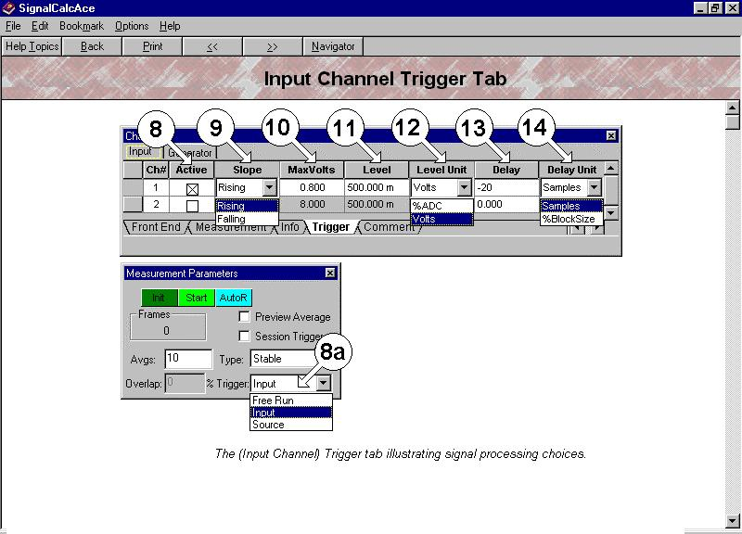
More Details Next Slide

Slide 26
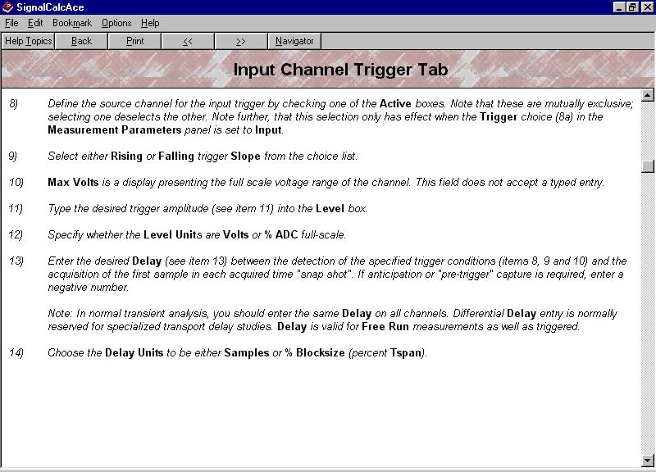
In the given case, we trigger off Channel 1, as channel 1 is the Hammer
Too high a trigger level requires a large excitation leading to nonlinear vibration whereas Too Low a trigger level can cause triggering even without any impact

Slide 27
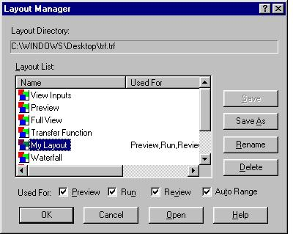
Saving the Test & using Layout Manager
Save the test at this point of time by clicking on the File, Save Menu. Save the test in the Temp directory with some unique file name
Click on Display => Layout Manager to get the screen shown above and Click on My Layout which may be renamed also
Check options Preview,Run, Review, Auto Range and Click Ok. This enables to save and retrieve the existing settings and graphs to be displayed later even in case of some unexpected system/software crash/failure

Slide 28
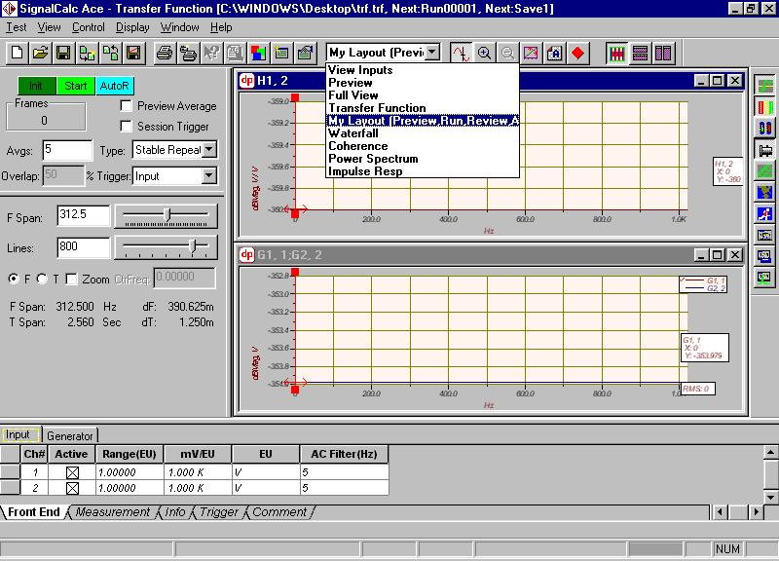
Click on My Layout in the Scroll Down Menu above
In case all the parameter options disappear click on the short cut buttons to regain the same
Close any graph windows except H1,2(Transfer Function window) open in the software at this time

Slide 29
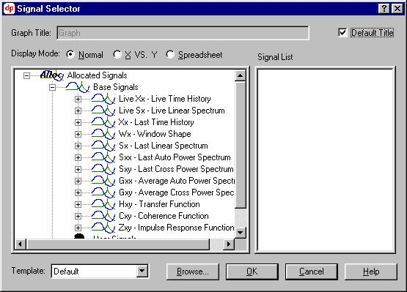
Displaying Graphs
Go to the Menu Bar
Click on Display
Click on New Graph, It displays the above screen

Slide 30
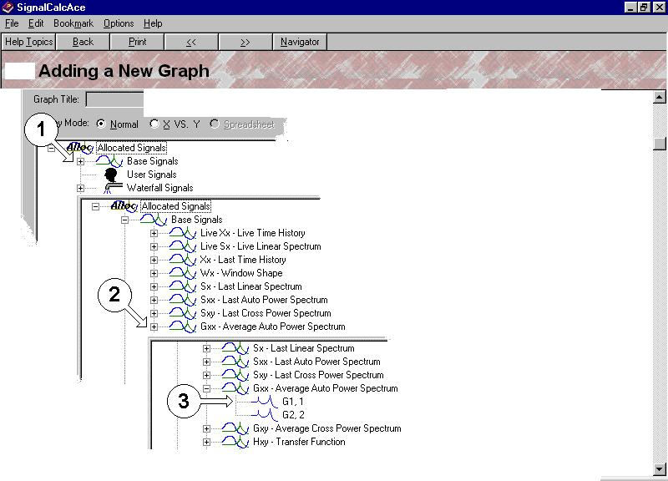
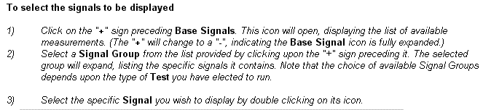
Displaying Graphs

Slide 31
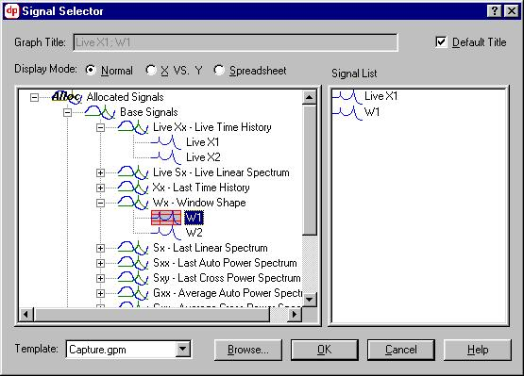
Graphs to be Displayed
Display the Live X1 and Window Shape W1 graph as described earlier
Live Signals with windows super posed represent the actual signal as in an oscilloscope
The graph title can be changed in the same state by unchecking the Default title option
Why these Graphs and what is their importance?

Slide 32
Importance of the Graphs Displayed
Coherence : Used to check quality of measurement under ideal condition.
If the measured output is entirely due to measured input then coherence is one.In practice, coherence drops from one after the first impact, but a value close to one is acceptable. Low coherence may be expected at anti-resonance but low coherence near resonance indicates problem with measurement.
Window: Force window may be used for channel 1 (assuming noisy signal).
Response window (exponential window) may be used for channel 2 to minimize leakage. However additional damping is introduced through the usage of this window.

Slide 33
Importance of Graphs Displayed
Auto power Spectrum of channel 1 (G11) is displayed to check whether appropriate frequency range is excited. It should not drop more than 20to 30dB in the frequency range of interest. Hammer tip may need to be changed for appropriate excitation. Also whether double impact occurred can be noticed in this graph.
Pre-trigger delay: Should be same for both channels (typically 2 to 5%of time block).

Slide 34
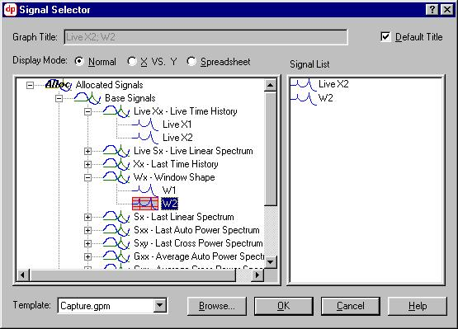
Graphs to be Displayed
Display the Live X2 and Window 2 Graph
The live time history signals with the windows superposed are used to select the appropriate window parameters and also check for any double impact or hits during the experiment

Slide 35
Graphs to be Displayed
Display the C 1,2 graph from the C x,y Coherence function of the base signals in the Signal Selector. The coherence should be as close to 1 as possible. Too low a coherence indicates error in measurement
Display the G1,1 graph from the G x,x Average Auto Power Spectrum function. It may be noted that the fall in the Magnitude should not be more than 20 to 30dB in the frequency range of interest
Also display the H1,2 graph in case it has been deleted. The peaks in H1,2 correspond to the natural frequencies of the system
Use the “Tile Windows Horizontally” function from the “Window” option from the main menu bar to display all the graphs in an orderly fashion
Save the test once again.

Slide 36
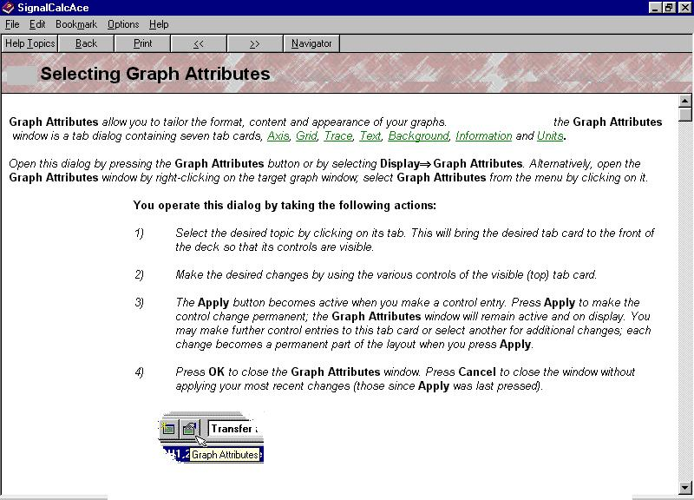

Slide 37
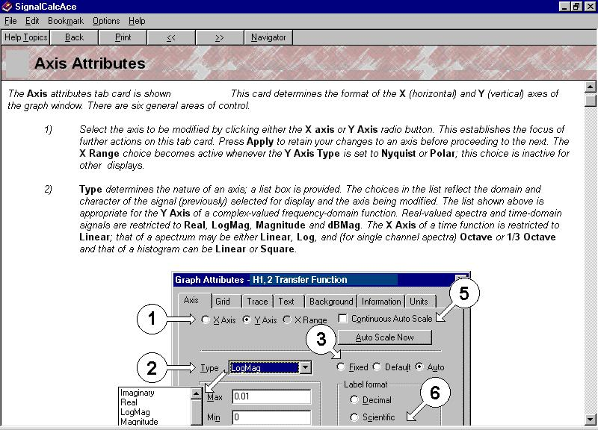
Contd.,

Slide 38
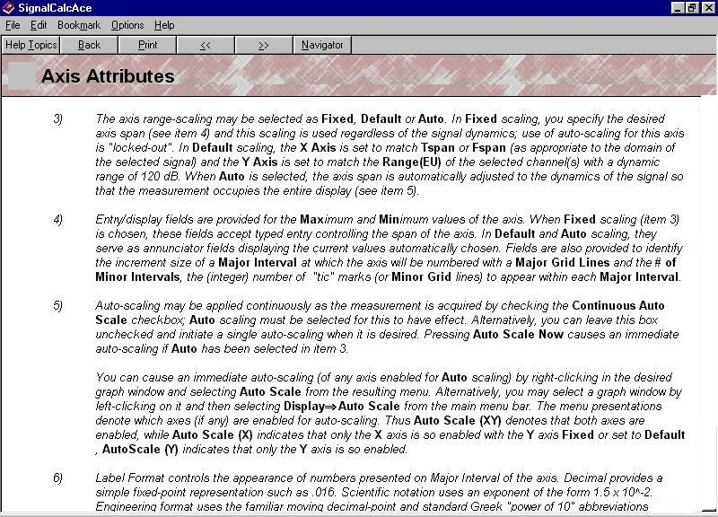

Slide 39
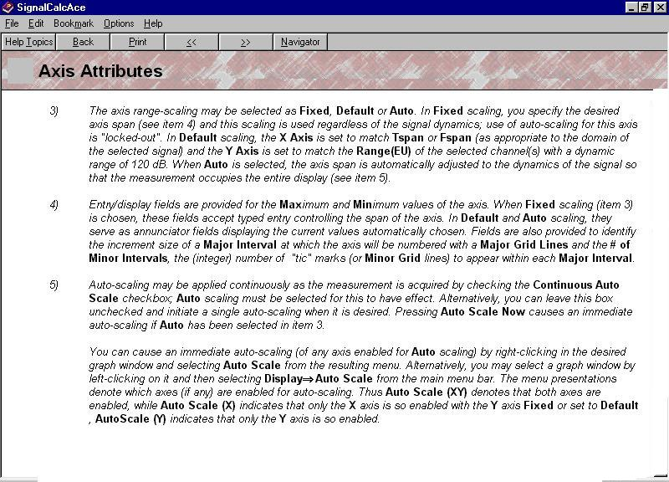
In the given experiment set the x-axis to frequency range of interest viz.,500 Hz and check the fixed option
The other graph attributes may be used while printing results for report

Slide 40
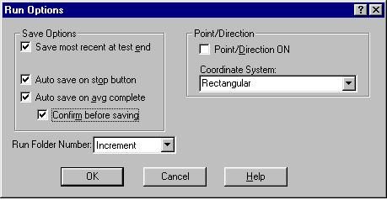
Before You start the Test..
Click on View => Run Options to set the run options
Each measurement taken is saved with a run number shown at the top of your screen
Check all the options and click OK
Save the test again

Slide 41
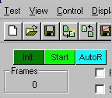
Starting the Test
After assuring the necessary connections, graphs and settings in the software, click on the Start button
At the left bottom corner of the screen you can see an instruction saying “Waiting for Trigger”
Observe that the Frames counter at the top will read “0” initially

Slide 42
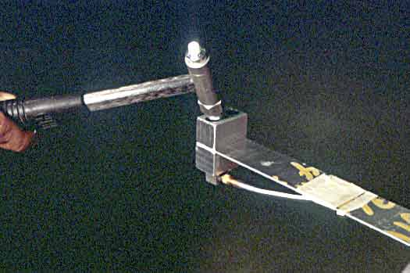
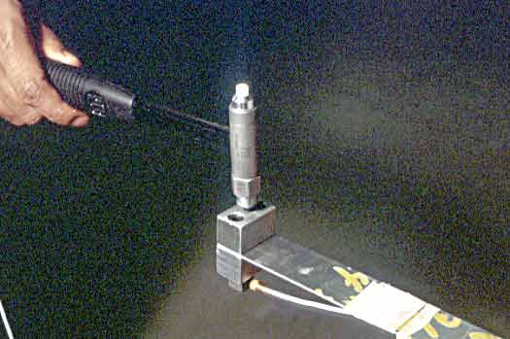
Running the Test
Strike the mass at the center gently and ensure that there is no double hit
If the strike is clean, a sharp single spike can be observed in the Live X1,W1 window
The ADC indicators will display green and the number of frames is incremented to 1
“Waiting for capture completion” and subsequently “Waiting for Trigger” instructions can be observed at the left bottom corner of the screen
Repeat the above steps till number of averages/frames are equal to 5(for given expt.)

Slide 43
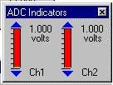
Oops..Some Problem!!!
Things may not be smooth as we expect
ADC indicators turn red indicating overrange
Also observe the warning “Filters Settling” at the left bottom corner of the screen
Allow the filters to settle down, try to change the values in the ADC indicators by clicking the adjust buttons shown and strike the mass again
Still no improvement…
Try to change the hammer tip and strike the beam with mass again after the filters settle
Filters not settling i.e, ADC indicators still in red for a long time…
Next Slide…..

Slide 44
Over range Problem
Sometime the Impact may be too high for the range set and it may take long for the filters to settle
In the given case, stop the test by pressing the “Stop” button. End the test by clicking “End”
Click “AutoR” button to get the ADC indicators back to normal
Adjust/increase the range by clicking on the adjust arrows
Check all other settings including “Run Options”
Save the test and Click on “Start” to restart the experiment
If the graphs displayed disappear at any point of time click on “My Layout” from the scroll down Display menu to retrieve your layout

Slide 45
No change in Frame Count??
The number of frames may not be incremented for any input you give.
Check for all the connections and settings
Check the “Trigger level”in the Channel Input parameters. Adjust it so that the trigger in not too high or too low
Try to strike the mass again
If there is no change, try increasing the gain by turning the knob on the ICP Battery Power unit,corresponding to the Hammer
Repeat the process

Slide 46
What is Success in the Experiment
The value of the first natural frequency from the H1,2 graph must agree with the theoretical results
The coherence should be as close to 1 as possible
The magnitude of G 1,1 should not drop more than 20 to 30dB in the frequency range of interest
The Live X1,W1 graphs should not indicate any double hits
You should be able to interpret any errors in the final values with valid reasons
Identify the possible sources of error and include in the discussion
Wait….You are not done yet…

Slide 47
Last..but not the Least
You are done with the experiment…but do your house keeping part.
Remove all the connections
Place the equipment in their respective boxes/holders
Turn off the power supply to the ICP Battery power units and the Weighing scale
Close the software and log off from the workstation
Be Professional

Slide 48
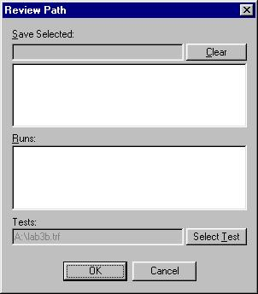
Reviewing Results Later
To review the results at a later point of time, Open the Signal calc software
Click on Test =>Review
Select the test by browsing the corresponding directory and filename
Open the run number desired to retrieve the results
Note that generally the latest measurement will be saved with the maximum Run number and maximum Save number
Return to First Slide

Slide 49
End
Return to First Slide

